Slide 1
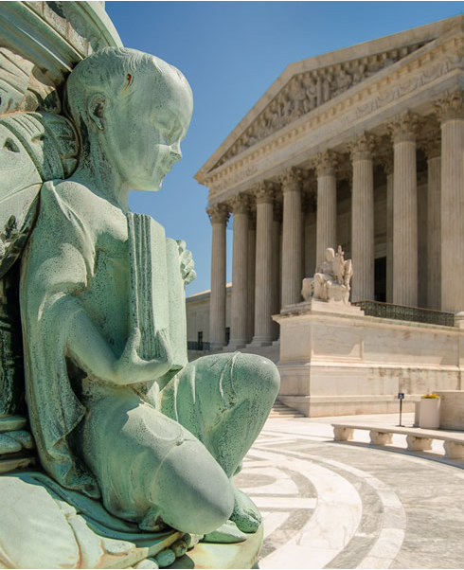

Sec. 230 Communications Decency Act (CDA)
Team Blue
Image: https://www.supremecourt.gov/images/11199-009.jpg

Slide 2

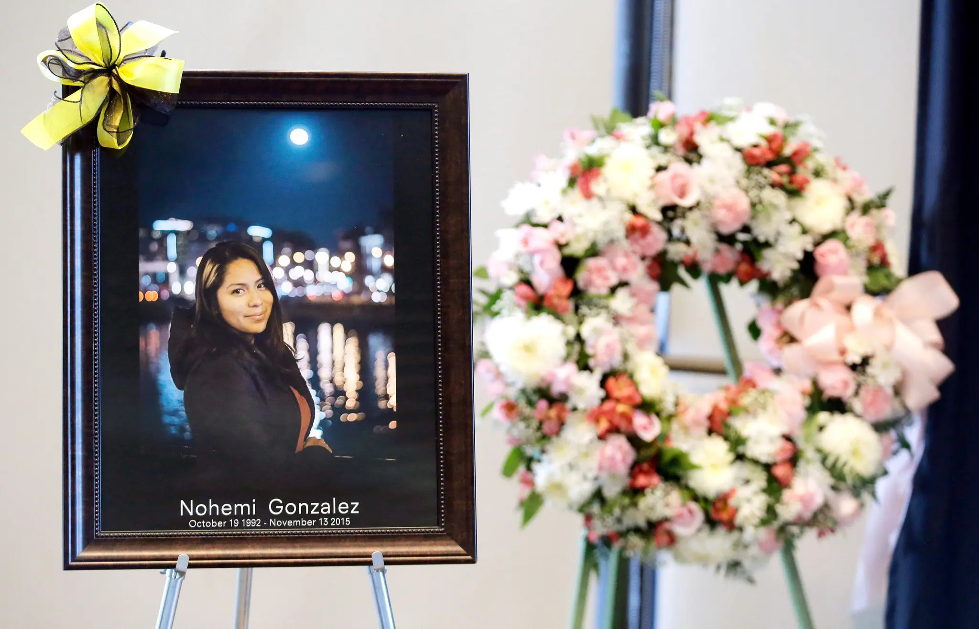



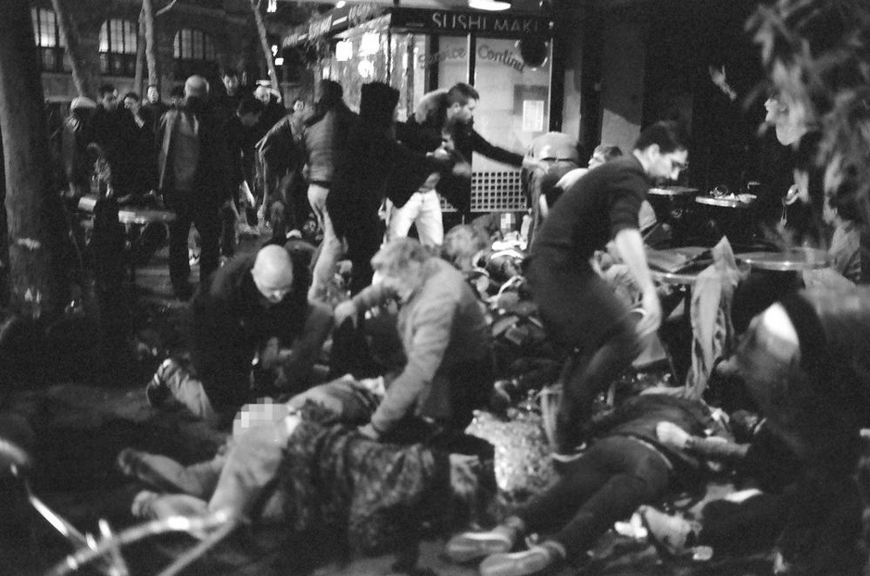


Nohemi Gonzalez October 19, 1992 – November 13, 2015 — GUNNED DOWN, PARIS —
ISIS
https://www.dni.gov/nctc/ftos.html
https://www.theguardian.com/world/ng-interactive/2015/nov/17/la-belle-equipe-paris-attacks-photographs
Chris Carlson/Associated Press
Notes:
On November 13, 2015, *CLICK* three ISIS terrorists *CLICK* gunned down 19 people at La Belle Équipe restaurant in Paris, France *CLICK* including Nohemi Gonzalez; a 23-year-old California State University-Long Beach student who was studying abroad. This was a part of a series of ISIS perpetuated attacks in France during which a total of 130 individuals were killed and nearly 400 wounded. ISIS, which had been designated as a foreign terrorist organization in accordance with the Immigration and Nationality Act “issued statements claiming responsibility for the attacks, including audio and video messages *CLICK* posted on YouTube, which is owned and operated by Google”.
The group posted “radicalizing videos” on YouTube. The videos included Google-supplied advertisements which generated revenue for both Google and ISIS. Three years later, based on the revenue sharing between Google and the content creator, *CLICK* Ms. Gonzalez’s estate and family brought a civil case against Google in the United States District Court of Northern California in 2018. *CLICK*

Slide 3
Gonzalez v. Google
The Attacks
ISIS terrorist attacks around Paris (November 2015)
Gonzalez v. Google (2017)
Nohemi Gonzalez’s estate sues Google for violating Anti-Terrorism Act in N.D.Ca. Dismissed w/ leave to amend.
Amended claim dismissed (2018)
Estate files an amended claim. Google moves to dismiss. Granted.
Estate appeals dismissed claim (2021)
April 4, 2022
Estate appeals to Supreme Court
Estate appeals dismissal in 9th Circuit. Affirmed in part, reversed and remanded in part.
Oral Argument (Feb, 2023)
The U.S. Supreme Court heard oral argument.
Gonzalez v. Google (2023)
The case is pending adjudication before the U.S. Supreme Court.

Slide 4

GONZALEZ v. GOOGLE
Is Google liable regarding the death of Nohemi Gonzalez under the Anti-Terrorism Act [18 U.S.C.A § 2333] based on Google’s ownership and operation of YouTube?
Does the YouTube Platform qualify as material support or resources for acts of terrorism for the purposes of determining Google’s liability under “18 U.S.C.A § 2339A – Providing material support to terrorists”?
The Questions
Is Google liable under 18 U.S.C. §2333(a) for knowingly providing “material support” to the content creator while knowing that the content creator “is a designated terrorist organization…, that the organization has engaged or engages in terrorist activity…, or that the organization has engaged or engages in terrorism”?
Did Google violate 18 U.S.C. §2339B(a)(1)? Which makes it unlawful for “Whoever knowingly provides material support or resources to a foreign terrorist organization, or attempts or conspires to do so”?
Did Google violate 18 U.S.C.§ 2339C(c) by concealing the provision of material support and resources to a designated foreign terrorist organization?
Did Google provide goods, funds or services to ISIS which violates the terrorism sanctions regulations issued pursuant to the International Emergency Economic Powers Act (‘‘IEEPA’’) and Global Terrorism Sanctions Regulations?
Notes:
The plaintiff provided 6 arguments to the court arguing that Google should be held liable for the death of Nohemi Gonzalez as

Slide 5
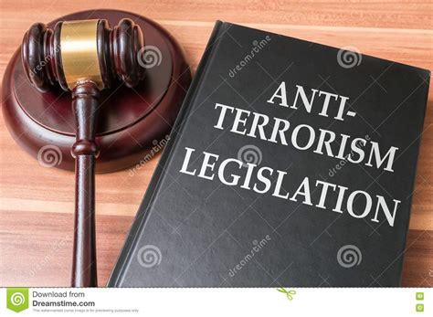
The Law
8 U.S.C.A. § 1189 – Designation of Foreign Terrorist Organizations
18 U.S.C.A § 2333 – The Anti-Terrorism Act
18 U.S.C.A § 2339A – Providing material support to terrorists
50 U.S.C. – International Emergency Economic Powers Act
31 CFR Subt. B – Global Terrorism Sanctions Regulations
47 U.S.C. § 230 – Communications Decency Act of 1996

Slide 6


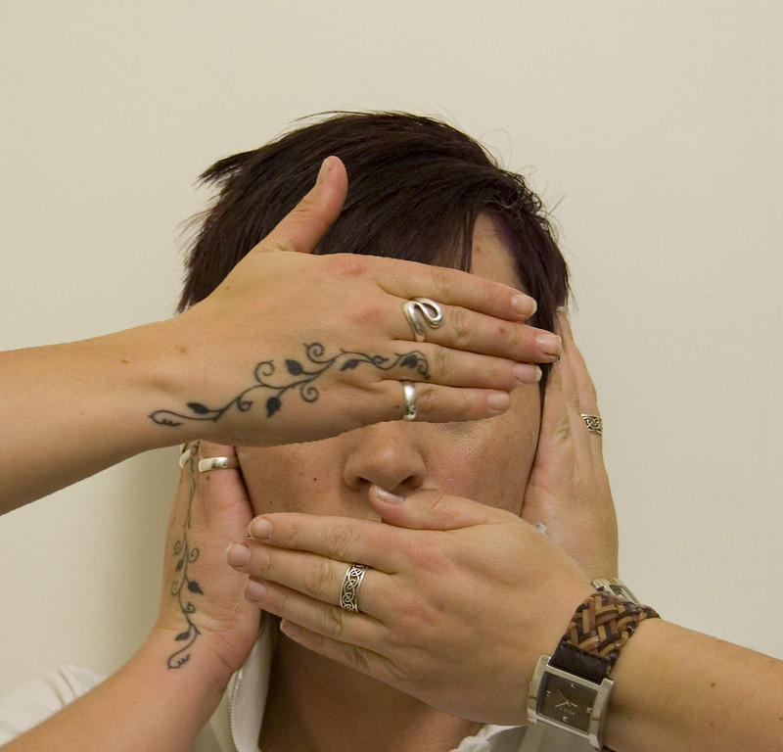
Did Google…
Give aid
Give support
Know they were terrorists
Know the attack was coming
Conceal complicity
Clare Black, Creative Commons
Notes:
Lower Court:
A brief overview (this can be helpful as we only have 1 minute per court):
The case of Gonzalez v. Google 335 F.Supp.3d 1156 (2018) involved a civil lawsuit filed against Google by the family of Nohemi Gonzalez, who was killed in the Paris terrorist attacks carried out by ISIS. The plaintiff alleged that Google's ownership and operation of YouTube aided ISIS in communicating and recruiting, thereby contributing to the attacks. The plaintiff made six claims under the Anti-Terrorism Act, 18 U.S.C. § 2333, but the court dismissed all of them, citing the Communications Decency Act, 47 U.S.C. § 230, which protects providers of online content from being treated as the publisher or speaker of information provided by another content provider. Appellate Court:
The appellate court affirmed the district court's decision, finding that the CDA immunizes interactive computer services from liability for third-party content, including content that supports or even encourages terrorism.
The court emphasized that the CDA's immunity provision serves a crucial public policy purpose of promoting free speech and protecting online innovation, and that any changes to the law should be left to Congress.
The court also rejected the plaintiffs' argument that the defendants should be held liable under the Anti-Terrorism Act, as the ATA requires direct support or financing of terrorism, which was not alleged in these cases.
Oral Argument:
Plaintiff claimed that the defendant cannot claim Section 230 immunity because of thumbnails. The idea of Biased Algorithm was brought into question; were the algorithm used on ISIS Recommended videos unique from regular recommended YouTube videos? The defendant claimed the algorithm used was the same throughout the platform.
Supreme Court:
The plaintiff claimed that other courts should not consider section 230 because;
Google is not being treated as a publisher of ISIS content, they shared recommendations or Thumbnails
Section 230 does not apply to recommended YouTube Video
The language used in the section 230 to describe information shared included
Section 230 is ambiguous and that Congress need to seek a balance between Section 230 coverage and State authorities over civil and criminal matters
Defendant, Google argued, they are immune to section 230 since YouTube displays content published by 3rd party creators
Multiple vehicle problems
Neutral algorithm all over the platform.

Slide 7

No – Section 230's protections have historically protected against similar cases, and would require a substantial change in philosophy
PREDICTION
Will Google be held liable for the claims brought against them?
What about the revenue sharing?
Goddard v. Google – recommendation algorithm suggesting keywords conducive to fraud, Google found not guilty
Fair v. Roommates – "content creator" vs. "service provider" in regards to Section 230 requires "materially contributing to its alleged unlawfulness"
Goddard v. Google – recommendation algorithm suggesting keywords conducive to fraud, Google found not guilty
Fair v. Roommates – "content creator" vs. "service provider" in regards to Section 230 requires "materially contributing to its alleged unlawfulness"
Notes:
Most likely, Google will be found not guilty. For claims 1-4, pertaining to Google's supposed promotion/dissemination of a terrorist message, previous cases (Goddard v. Google) can be used as almost a direct comparison to assert that algorithmic suggestions, even if they suggest illicit content, do not qualify Google as a "content creator" under Section 230 guidelines. Google remains a service provider for the purposes of receiving 230 protections, as the algorithm – although it does promote specific content to specific users – is neutral in terms of what it promotes, and has no bias towards any particular type of content (specifically, in this case, terrorist content). Thus, the only claims that could have any basis are 5 and 6, pertaining to the revenue sharing. However, as the District Court asserted, these claims are merely an attempt to repackage the idea that the plantiff is pushing with claims 1-4, and there is not enough demonstrated proximate cause that would result in these claims having substantial weight. Additionally, it would represent a significant paradigm shift for what would be viewed as unprotected by Section 230, and the Supreme Court is unlikely to make such a ruling themselves without any significant precedential support.

Slide 8
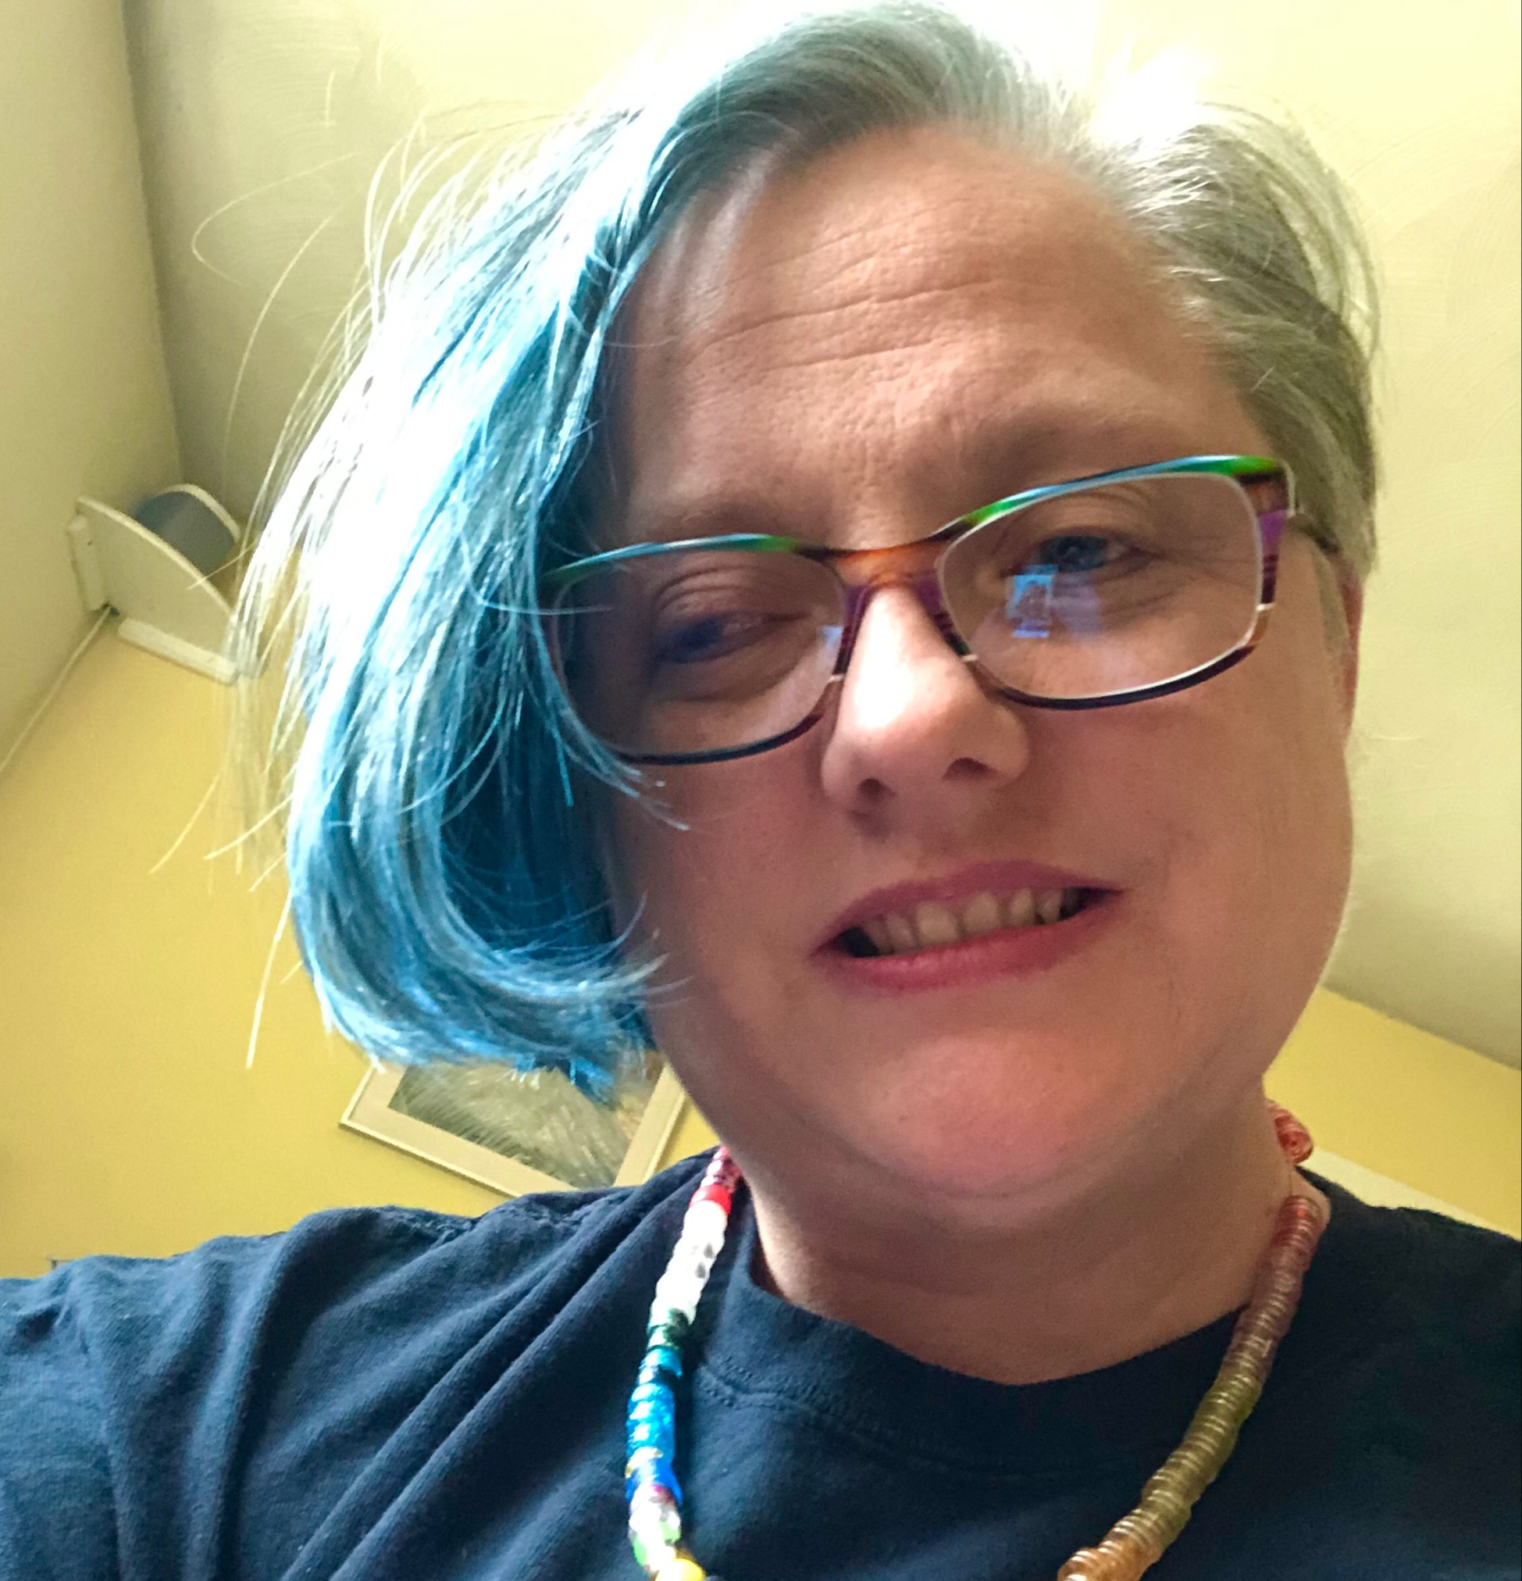





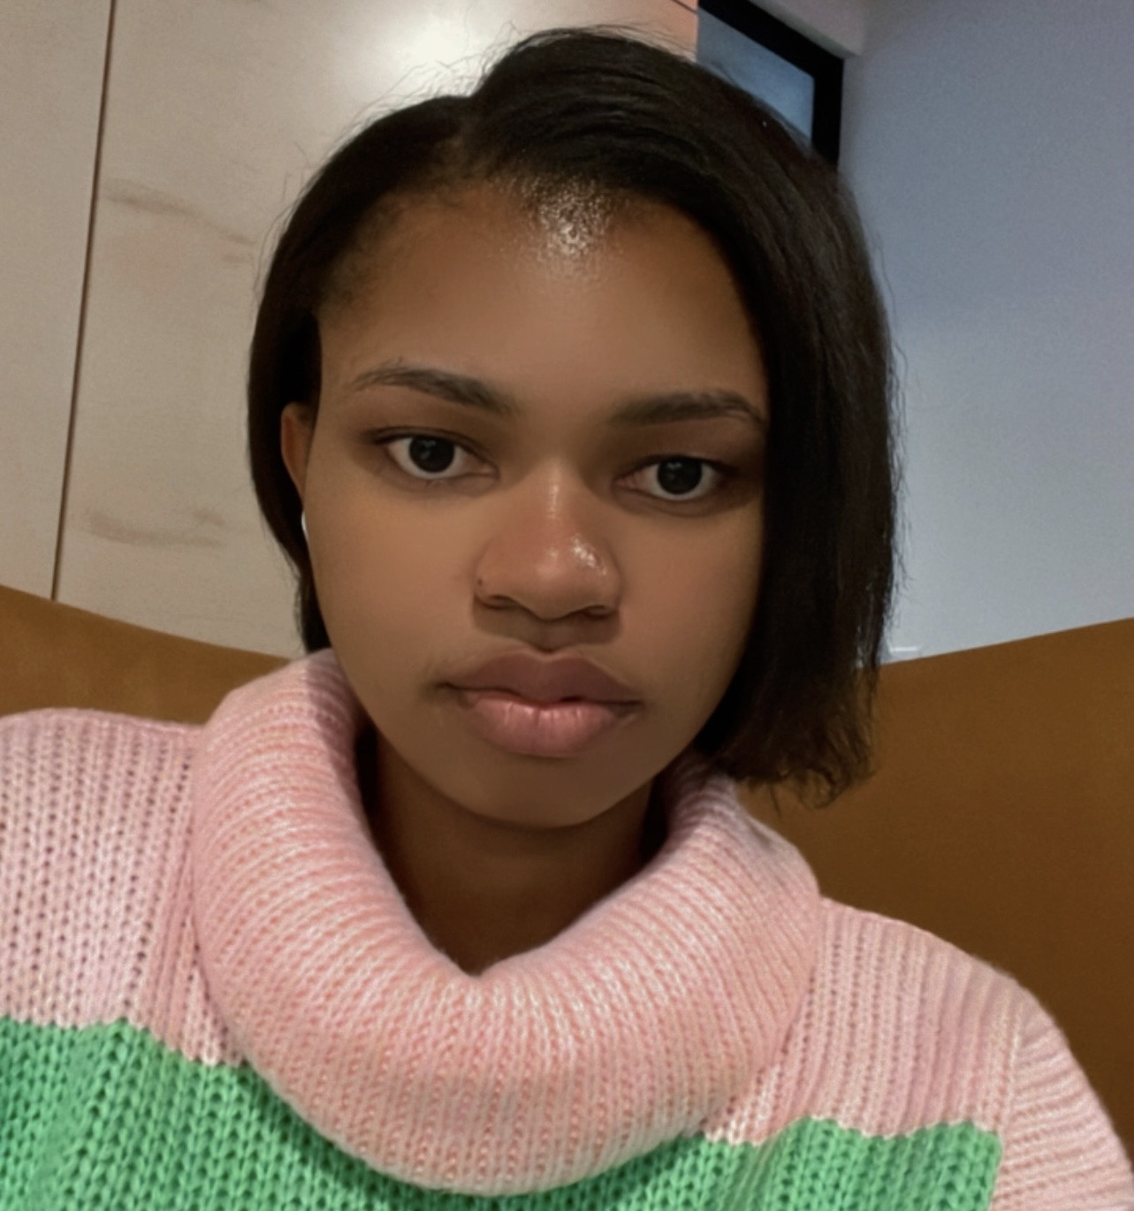
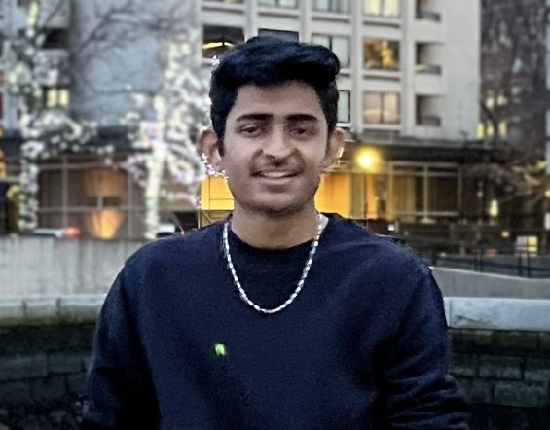
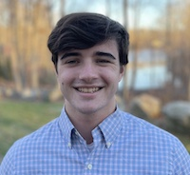
Thank You
Julie Tittler
Achat Poojitha
Hritesh Sonawane
Ronnie Sekamwa
Introduction, PPT, Chief Editor
Section 230
Lower Court Analysis
Lower Court Analysis
Keerthana Thangavelu
Vanessa Kibaja
Bhavesh Jain
Edward Baroncini
Appellate Court Opinion
Supreme Court Analysis
Oral Arguments
Prediction
Notes:
Appreciation to the team for researching and putting together this presentation.

